Slide 1

Introduction to Data Structures

Slide 2
Data Structures
Definition
Definition: Data Structure is a way to store or organize data in such way that it can be used / accessed efficiently.

Slide 3
Classification of Data Structures
Data Structures are majorly classified into 2 types
Linear Data Structures
Non-Linear Data Strctures

Slide 4
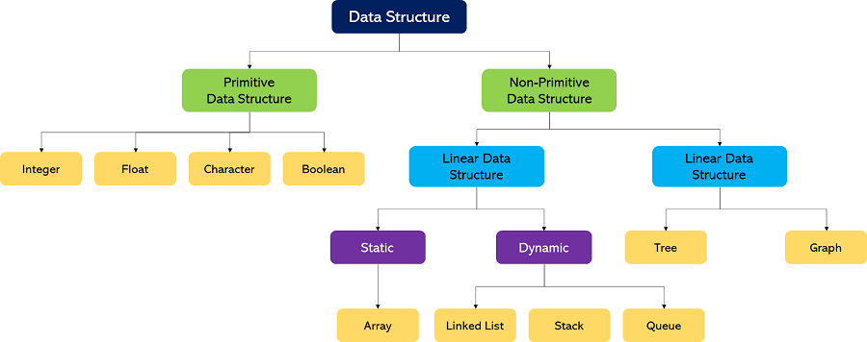
Detailed Classification

Slide 5
Linear Data Structures
The arrangement of data in a sequential manner is known as a linear data structure
In these data structures, one element is connected to only one another element in a linear form
Examples
Arrays
Linked Lists
Stacks
Queues

Slide 6
Non
Linear Data Structures
Non-Linear Data Structures are data structures where the data elements are not arranged in sequential order.
There exists a hierarchical relationship between the individual data items.
Examples
Trees
Graphs

Slide 7
Let’s understand the importance of each linear data structure one by one.

Slide 8
Arrays

Slide 9
Arrays
Arrays are defined as the collection of similar types of data items stored at contiguous memory locations
Array elements are indexed (Starting from 0) and we can access elements using indices

Slide 10
Advantages of Arrays
Multiple values under a single name
Traversing is easy (Contiguous memory locations)
Accessing an element is very easy (Just use the index)

Slide 11




Disadvantages of Arrays
Homogeneous
Static memory allocation (If it’s a static array)
Wastage of Memory
Difficulty of insertion and deletion

Slide 12
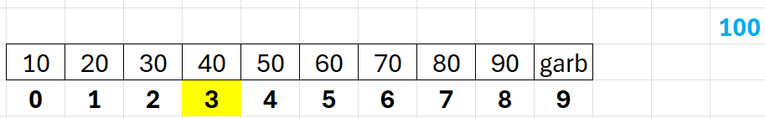
Why deleting or inserting an element in an array is tedious?
Consider the following array of 10 elements where index 9 is empty (Currently a garbage value is sitting there.
Technically the array only contains 9 elements and now you want to insert a new element 100 at index 3
Remember insertion doesn’t mean replacement.

Slide 13
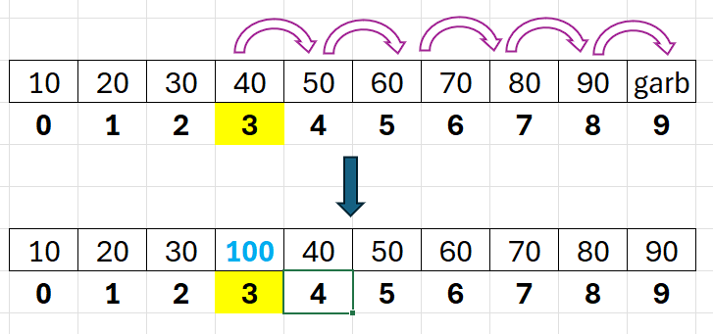
Why deleting or inserting an element in an array is tedious?
We should do the following to in-order to insert 100 at 3rd index

Slide 14

Why deleting or inserting an element in an array is tedious?
Let’s see deleting an element from the below array now. Say we want to delete 60
Remember after deleting we should be able to access 70 after 50

Slide 15
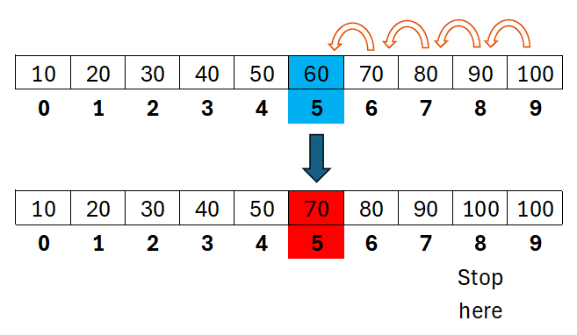
Why deleting or inserting an element in an array is tedious?
We should do the following to delete 60

Slide 16

To deal with those disadvantages we have a concept called

Slide 17

Linked Lists

Slide 18
Linked Lists
Linked list is a linear data structure that includes a series of connected nodes. Linked list can be defined as the nodes that are randomly stored in the memory.
01
A node in the linked list contains two parts, i.e., first is the data part and second is the address part. The last node of the list contains a pointer to the null.
02

Slide 19
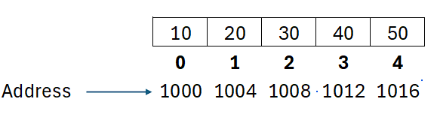
Array (Elements at contiguous memory locations)

Slide 20
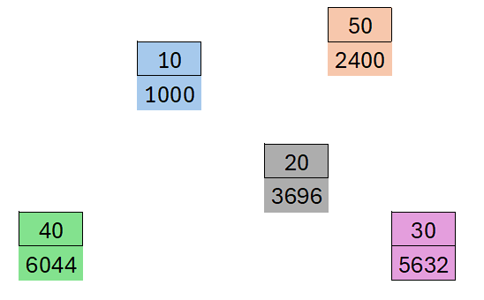
Linked List (Elements stored at random memory locations)
Elements stored at different addresses. But How to go from one element to another?

Slide 21
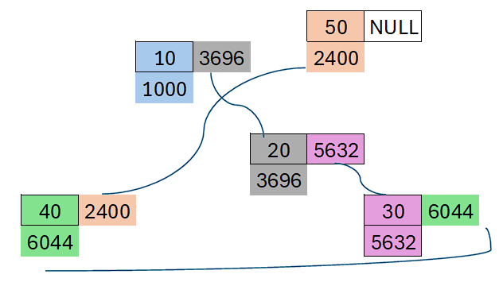
Linked List (Elements stored at random memory locations)
The idea is to somehow store the address of the other element along side the value of current element.

Slide 22
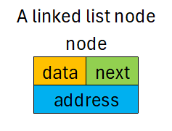
Linked List Nodes
Linked list node contains 2 parts
  Data Part (To store the value)
  Next Part (To store the address of the next element)
Here’s how a linked list node will look like

Slide 23
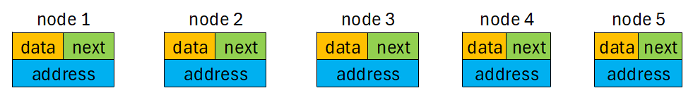
Linked List Nodes
This is how a linked list representation of 5 integers look like

Slide 24
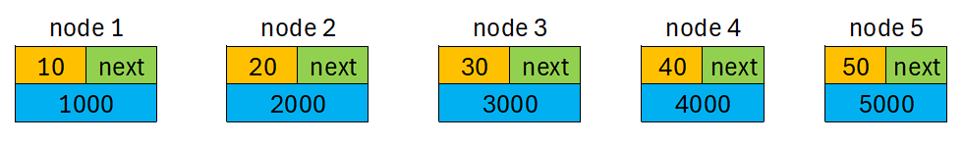
Linked List Nodes
Every node contains its own address and can have some value at data part.

Slide 25
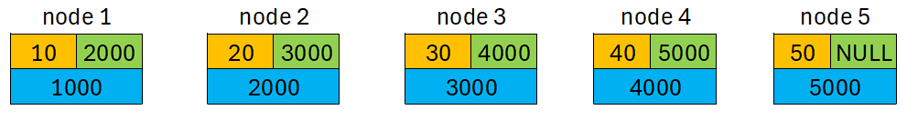
Linked List Nodes
Now comes the linking part. The idea is to store the address of NEXT NODE in PREVIOUS NODE to maintain connectivity.

Slide 26
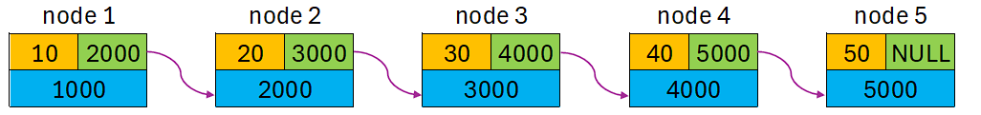
Linked List Nodes
By doing this we give connection from one node to another. Last node is connected to nothing else so we store NULL.

Slide 27
Types of Linked Lists
Singly Linked List
Doubly Linked List
Circular Linked List

Slide 28
Linked List Operations
Insertion
Deletion
Search
Reverse
Sort

Slide 29
Advantages of Linked Lists

Slide 30
Dynamic and Memory Efficient
Linked List doesn’t have a fixed size.
Based on the requirement, N number of nodes can be added.
The size of linked list can grow or shrink according to the requirement. So there won’t be any scope for wasting of memory.

Slide 31
Insertions & Deletions are relatively easy
Unlike arrays, insertion, and deletion in linked list is easier.
Array elements are stored in the consecutive location, whereas the elements in the linked list are stored at a random location.
To insert or delete an element in an array, we must shift the elements for creating the space.
Whereas, in linked list, instead of shifting, we can just update the address of the pointer of the node.

Slide 32
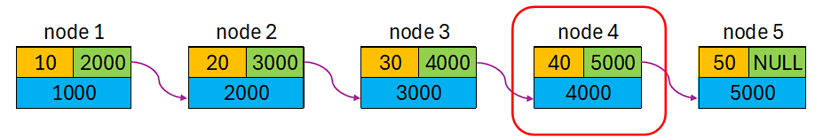
Deleting an element from a linked list
Say we want to delete the 4th node from the below linked list

Slide 33
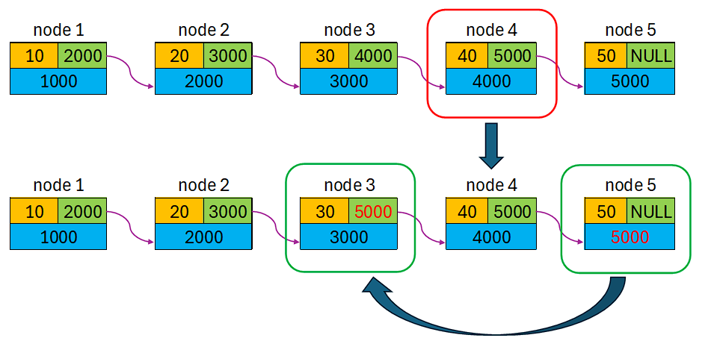
Deleting an element from a linked list

Slide 34
Disadvantages of linked lists
Memory usage - In linked list, node occupies more memory than array. Each node of the linked list occupies two types of variables, i.e., one is a simple variable, and another one is the pointer variable.
Traversal - Traversal is not easy in the linked list. If we have to access an element in the linked list, we cannot access it randomly, while in case of array we can randomly access it by index. For example, if we want to access the 3rd node, then we need to traverse all the nodes before it. So, the time required to access a particular node is large.
Reverse traversing - Backtracking or reverse traversing is difficult in a linked list. In a doubly-linked list, it is easier but requires more memory to store the back pointer.

Slide 35
Applications of linked lists
Polynomial Representation
Sparse Matrix Representation
Implementations of other data structures like stacks and queues
Adjacency List representation for Graphs

Slide 36
Where are linked lists being used?
Image viewers
Previous and next pages in web browsers
Music player
Forward and backward in File explorers and many more

Slide 37

Stacks

Slide 38

Stack
(Last In First Out (LIFO) or
(First In Last Out (FILO)) Structures
A Stack is a linear data structure that follows the LIFO (Last-In-First-Out) principle
01
The element inserted last will be the first element to be taken out.
02
Operations on stack will be done from only ONE END called top
03

Slide 39
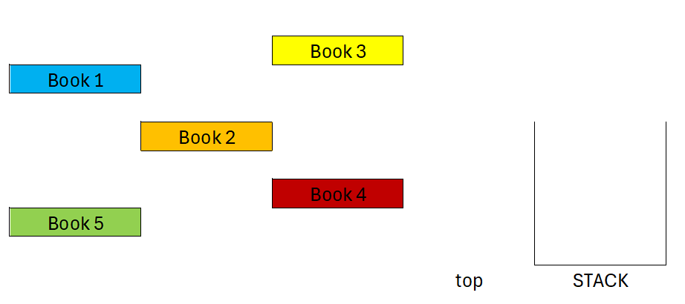
Here’s an example (Organizing Books)

Slide 40
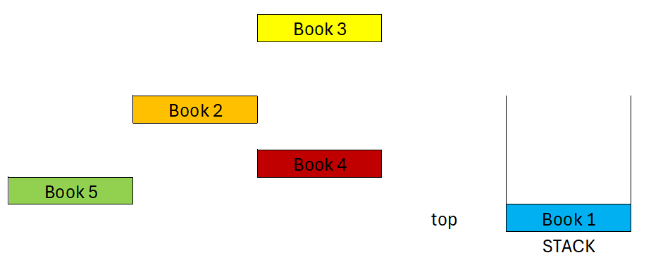
Inserting 1st Book

Slide 41
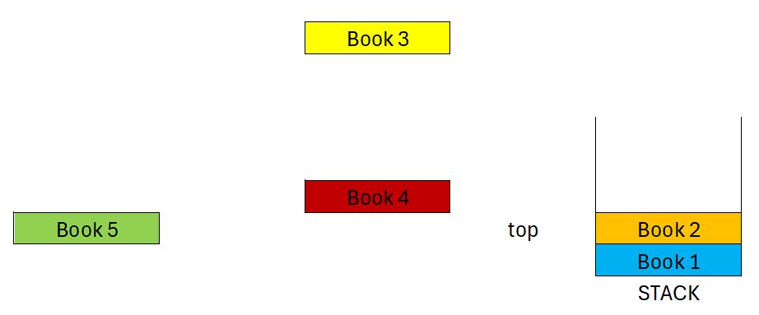
Inserting 2nd Book

Slide 42
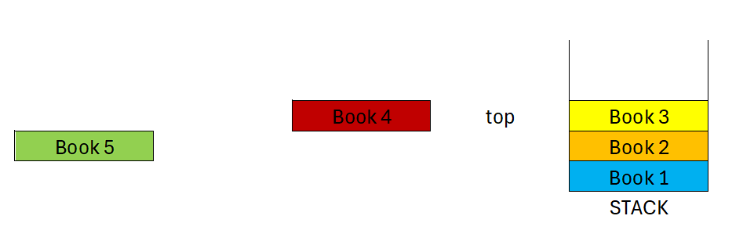
Inserting 3rd Book

Slide 43
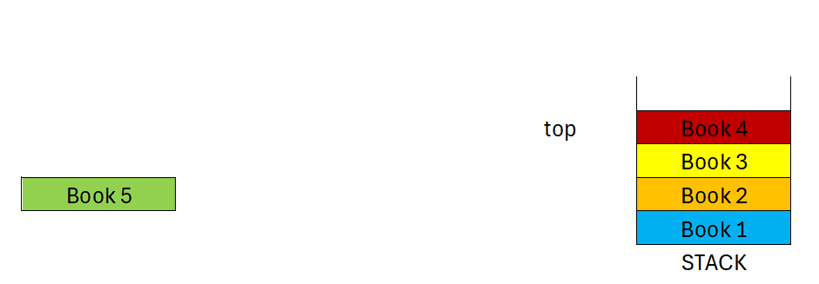
Inserting 4th Book

Slide 44
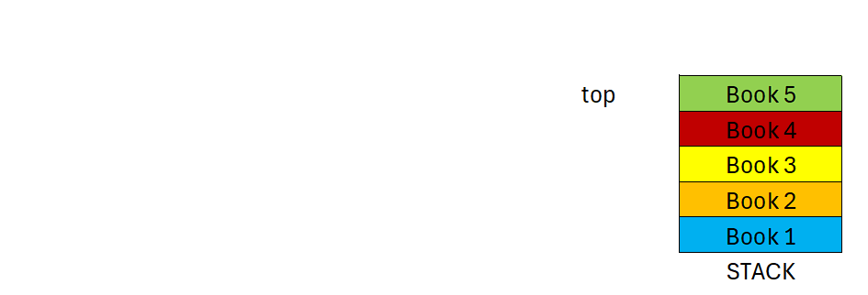
Inserting 5th Book

Slide 45
Now deleting the books inserted

Slide 46
Deleting Book 5 (Which was inserted as the LAST element into the stack)

Slide 47
Deleting Book 4

Slide 48
Deleting Book 3

Slide 49
Deleting Book 2

Slide 50
Deleting Book 1 (Thus by making Stack empty)

Slide 51

Stack Operations
Push(): Inserting a new element into the stack
Pop(): Deleting an element from the stack
isEmpty(): Checking if stack is empty (Underflow Condition)
isFull(): Checking if stack is full of elements (Overflow Condition)
peek(): Having a look at the element currently on top
display(): Printing all the stack elements.

Slide 52
Stacks can be implemented using
An Array
A Linked List

Slide 53

Applications of Stack
Arithmetic Expression Evaluations
Balancing parentheses
Recursion
Backtracking
Reversal Operations
Undo / Redo Operations in Text Editors

Slide 54

Queue

Slide 55
Queue
(First In First Out - FIFO)
01
FIFO Principle
The element inserted first will be the first element to be removed.
02
Two Ends
Insertion (Enqueue) happens at the REAR and deletion (Dequeue) at the FRONT.
03
Linear Structure
Queue is a linear data structure, just like a line of people waiting for service.

Slide 56
Think of it like a line at a ticket counter!

Slide 57
Queue Operations
enqueue()
Insert element at the REAR of the queue
dequeue()
Remove element from the FRONT of the queue
peek()
View the element at the FRONT without removing
isEmpty()
Check if the queue has no elements (Underflow)
isFull()
Check if the queue is full (Overflow)
display()
Print all elements from FRONT to REAR

Slide 58
Types of Queues
Simple Queue
Basic FIFO — elements inserted at rear, removed from front
Circular Queue
Last position connects back to first, forming a circle. No wasted space.
Double-Ended Queue
(Deque)
Insertion and deletion can happen at BOTH ends
Priority Queue
Elements are served based on priority, not insertion order

Slide 59
Applications of Queue
CPU Scheduling (Process scheduling in OS)
Printer Spooler (Jobs printed in order of arrival)
Breadth-First Search (BFS) in Graphs
Keyboard Buffer (characters typed stored in queue order)
Traffic Management Systems
Call Center Systems (customers served in order)

Slide 60
Queue can be implemented using
Array-based Queue
Linked List-based Queue
Fixed size, simple implementation
Front and Rear pointers track positions
Limitation: Wasted space after deletions (solved by Circular Queue)
Dynamic size — no size limit
No wasted space after deletions
Each node holds data and pointer to next node

Slide 61
Now let's explore Non-Linear Data Structures

Slide 62
Trees

Slide 63
Trees
01
Hierarchical Structure
A tree is a non-linear data structure with a root node and subtrees of children, represented as a set of linked nodes.
02
No Cycles
Unlike graphs, trees do not contain cycles. There is exactly ONE path between any two nodes.
03
Root & Leaves
The topmost node is called the ROOT. Nodes with no children are called LEAF nodes.

Slide 64
Tree Terminology
Root
The topmost node of a tree with no parent
Parent
A node that has one or more child nodes
Child
A node that descends from a parent node
Leaf
A node with no children (terminal node)
Height
Number of edges from root to deepest leaf
Degree
Number of children a node has

Slide 65
Types of Trees
Binary Tree
Each node has at most 2 children: left and right
Binary Search Tree (BST)
Left child < Parent < Right child. Enables fast search.
AVL Tree
Self-balancing BST where height difference between subtrees is at most 1
Heap
Complete binary tree: Max-Heap (parent >= children) or Min-Heap

Slide 66
Tree Operations
Insert
Add a new node at the appropriate position
Delete
Remove a node and restructure the tree
Search
Find a node with a given value
Traversal (In-order)
Left -> Root -> Right — gives sorted output in BST
Traversal (Pre-order)
Root -> Left -> Right
Traversal (Post-order)
Left -> Right -> Root

Slide 67
Applications of Trees
File System Representation (Folders & Subfolders)
Database Indexing (B-Trees, B+ Trees)
Expression Evaluation (Expression Trees)
HTML/XML DOM (Document Object Model)
Decision Trees in AI and Machine Learning
Heaps used in Priority Queues & Heap Sort
Auto-complete suggestions (Trie)

Slide 68
Graphs

Slide 69
Graphs
01
Vertices & Edges
A graph G = (V, E) consists of a set of Vertices (V) and a set of Edges (E) connecting pairs of vertices.
02
Flexible Structure
Unlike trees, graphs can have CYCLES, multiple paths between nodes, and no single root node.
03
Directed or Undirected
In directed graphs, edges have direction (A -> B). In undirected graphs, edges go both ways (A - B).

Slide 70
Graph Terminology
Vertex (Node)
A fundamental unit / point in the graph
Edge
A connection (link) between two vertices
Degree
Number of edges connected to a vertex
Path
A sequence of vertices connected by edges
Cycle
A path that starts and ends at the same vertex
Weight
A value associated with an edge (Weighted Graph)

Slide 71
Types of Graphs
Based on Direction
Based on Connectivity
Undirected Graph: Edges have no direction (bidirectional)
Directed Graph (Digraph): Edges have a specific direction
Weighted Graph: Each edge has an associated weight/cost
Unweighted Graph: Edges have no weights
Connected Graph: There is a path between every pair of vertices
Disconnected Graph: Some vertices are not reachable from others
Complete Graph: Every vertex is connected to every other vertex
Cyclic / Acyclic: Graph with or without cycles (DAG = Directed Acyclic Graph)

Slide 72
Graph Representations
Adjacency Matrix
Adjacency List
A 2D array of size V x V
matrix[i][j] = 1 if edge exists between vertex i and j
Simple but uses O(V^2) space
Best for dense graphs
Array of linked lists or arrays
Each index stores a list of neighbors
Space efficient: O(V + E)
Best for sparse graphs

Slide 73
Graph Traversal Algorithms
BFS
(Breadth-First Search)
Explore level by level from source. Uses a QUEUE. Finds shortest path in unweighted graphs.
DFS
(Depth-First Search)
Explore as far as possible along a branch before backtracking. Uses a STACK or Recursion.
Dijkstra's Algorithm
Finds the shortest path in a weighted graph from a source vertex to all others.
Kruskal's Algorithm
Finds the Minimum Spanning Tree by sorting edges and adding smallest non-cycle edges.

Slide 74
Applications of Graphs
Social Networks (Facebook friend connections, LinkedIn)
Maps & Navigation (Google Maps, Shortest Path algorithms)
Web Page Ranking (Google's PageRank algorithm uses directed graphs)
Network Routing (Computer networks, Internet routing protocols)
Recommendation Systems (Amazon, Netflix — items connected by similarity)
Scheduling Problems (Task dependencies represented as DAGs)
Electrical Circuits (Circuit analysis and design)

